Slide 1

AquaChain Commercialization Overview
Team 1: Mihir, William, Shruti, Rachana, Patrick

Slide 2
The Commercialization Process
01
03
04
02
Development costs
Financials
Cost of Developing.
How are our numbers?
Sales forecast
Valuation
How much do we anticipate?
What we believe.
Slide by Mihir

Slide 3
02
Development & Production Costs
Slide by Mihir

Slide 4
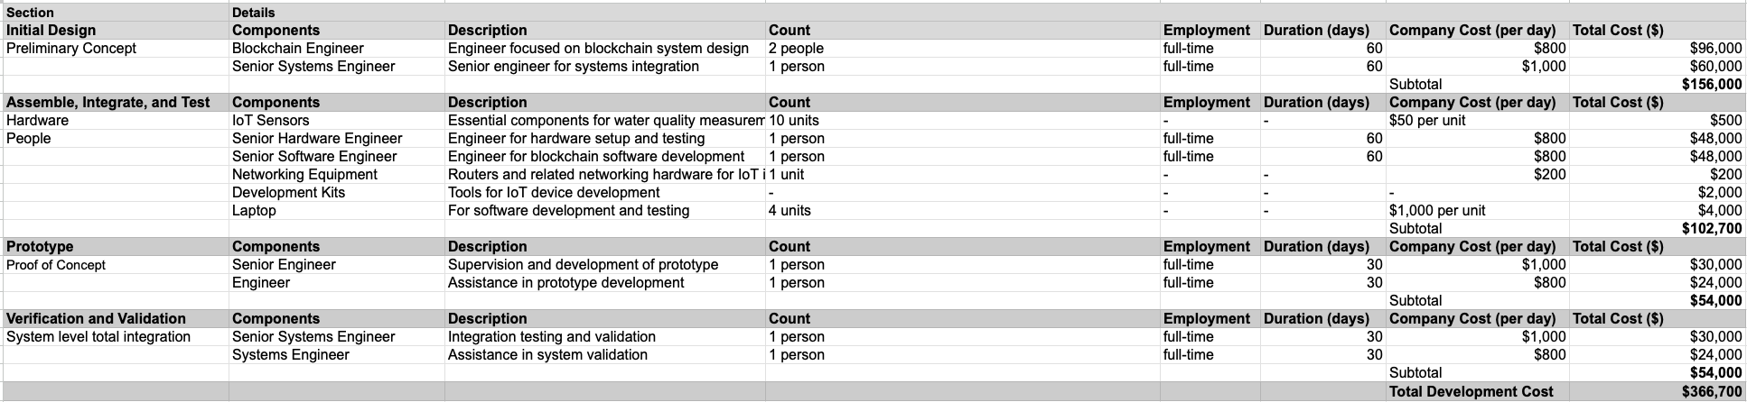
Development costs
Slide by Mihir

Slide 5
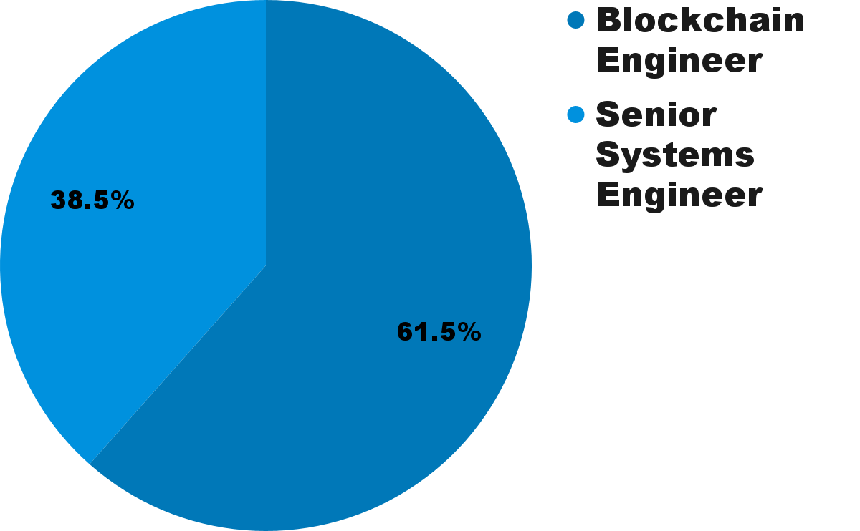
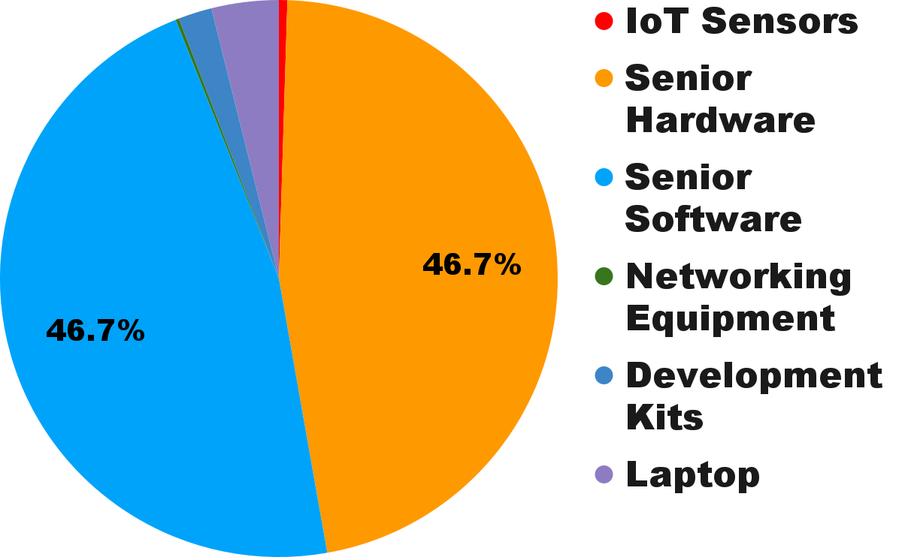
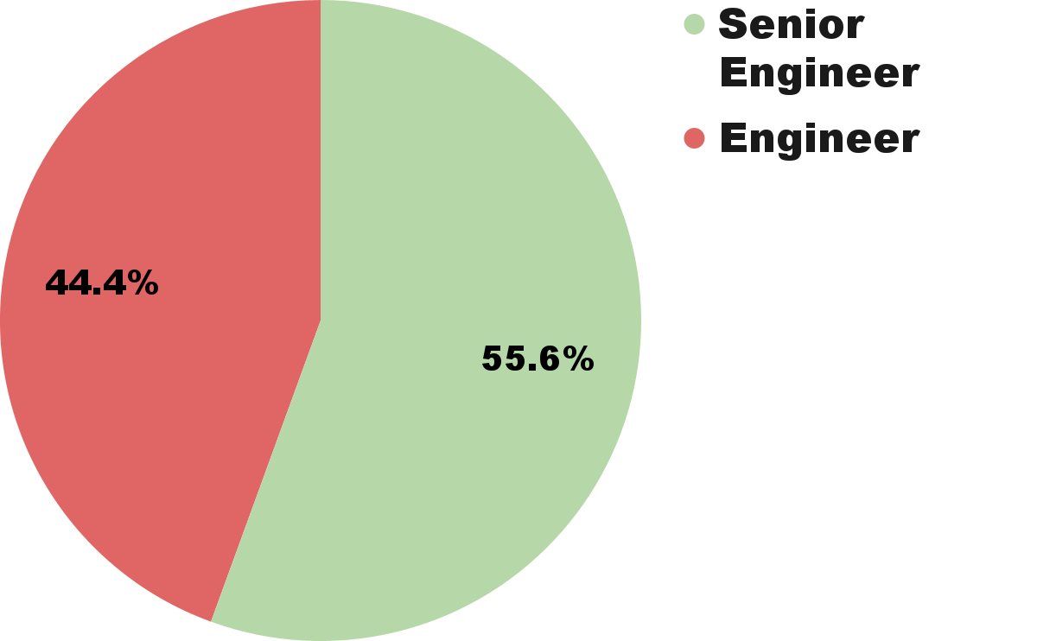
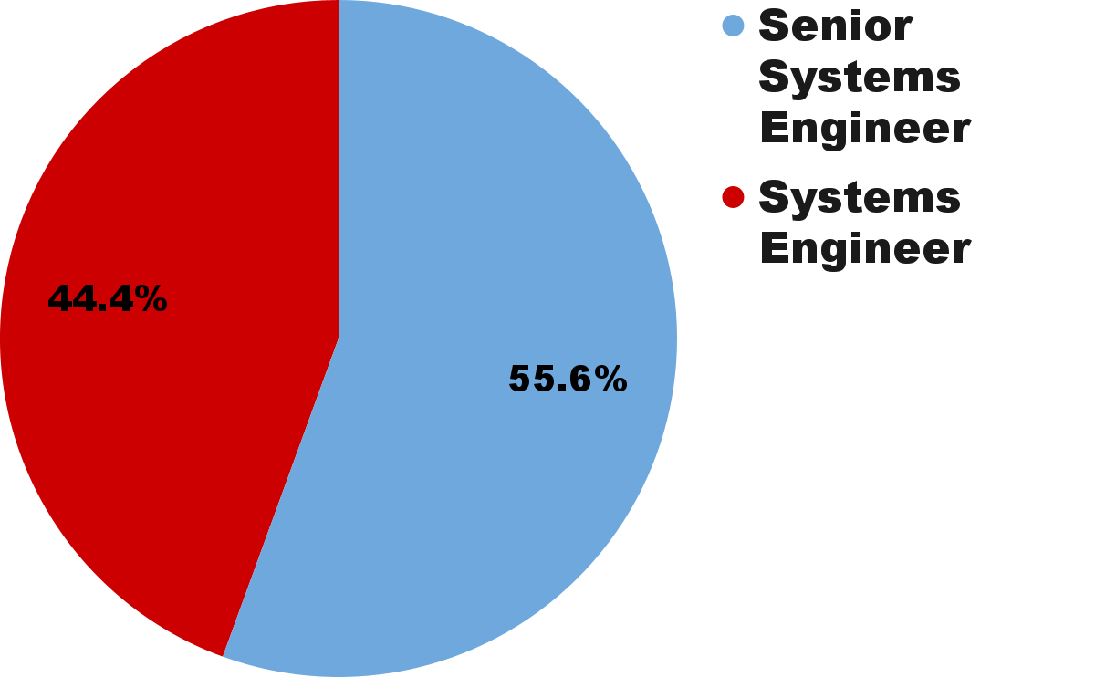
Development costs
Initial Design
Assemble
Subtotal | $156,000
Subtotal | $102,700
Total Development Cost | $366,700
Prototype
Verification
Subtotal | $54,000
Subtotal | $54,000
Slide by Mihir

Slide 6
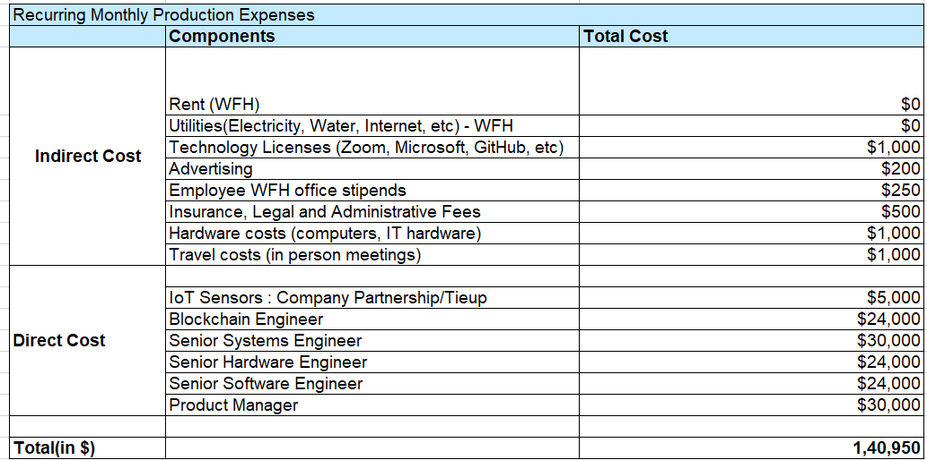
Production Costs : Table

Slide 7

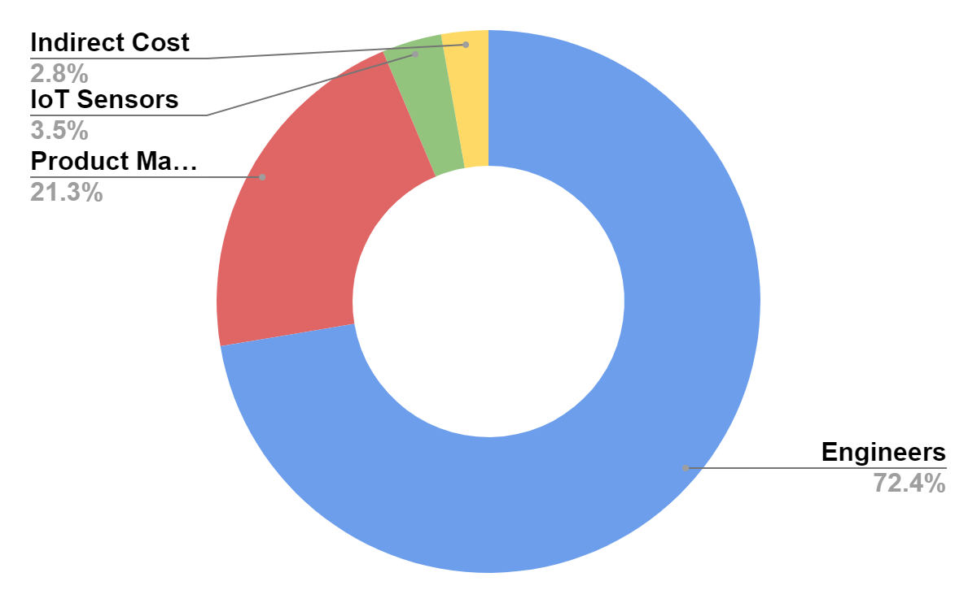
Production costs
Slide by William

Slide 8
03
Sales Forecast
Slide by Shruti

Slide 9
Sales Forecast
Year | Clients in Pipeline | Client Growth (%) | Conversion Rate | Price per Unit ($) | Annual Units Sold | Revenue
2024 | 10,000 | 0 | 10% | $174.48 | 1,000 | $174,480.00
2025 | 13,000 | 30% | 15% | $174.48 | 1,950 | $340,236.00
2026 | 15,600 | 20% | 20% | $191.93 | 3,120 | $598,815.36
2027 | 17,940 | 15% | 20% | $191.93 | 3,588 | $688,637.66
2028 | 19,734 | 10% | 30% | $211.12 | 5,920 | $1,249,890.38

Slide 10
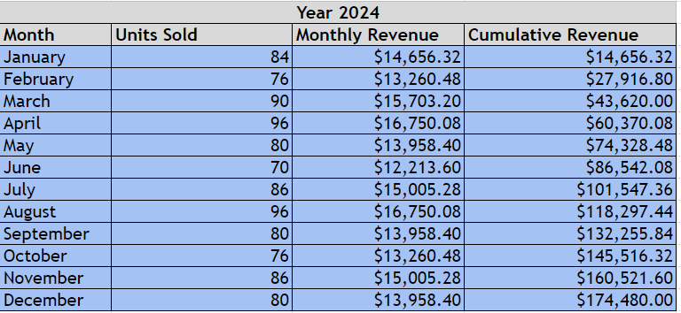
Sales Forecast

Slide 11
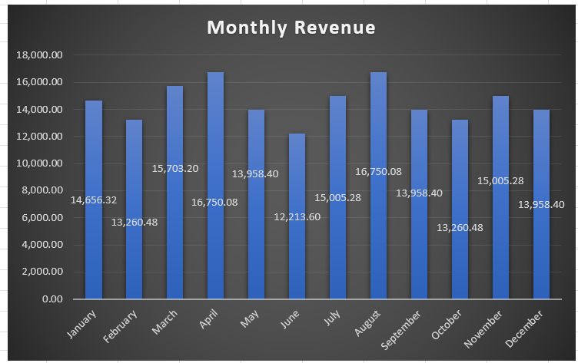
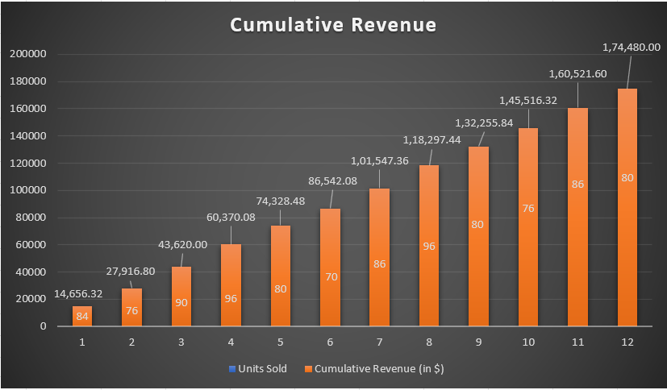
Sales Forecast Graph
Link for cumulative and monthly revenue calculations provided below
Slide by Shruti
Notes:
https://docs.google.com/spreadsheets/d/1N7ll9g7sK9DtGcDIy4uaYeHEGla8wIiO8u3AVWfr7NA/edit?usp=sharing

Slide 12
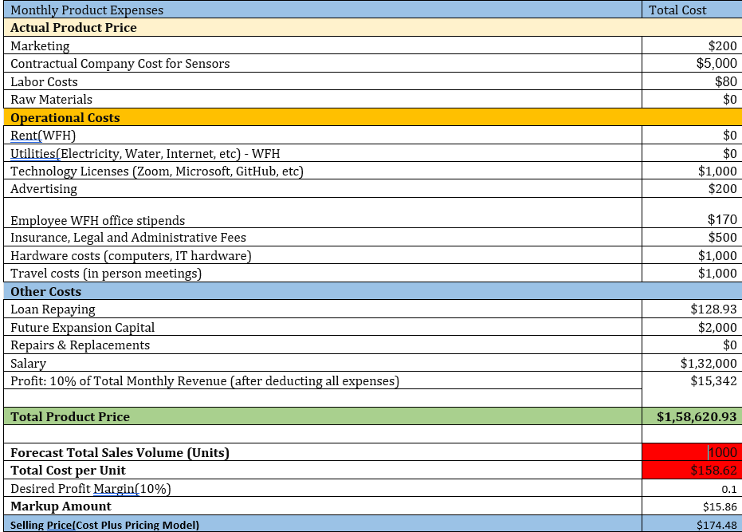
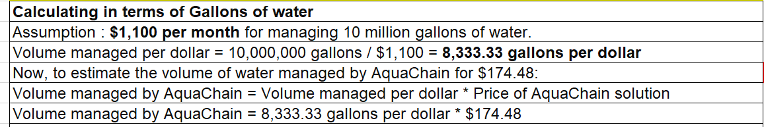
Pricing Model : Table
Slide by Rachana

Slide 13

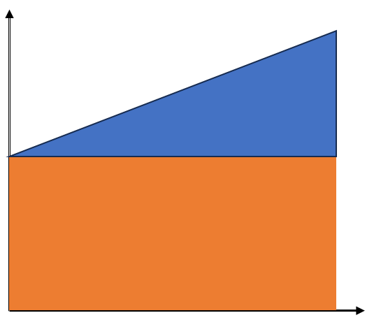
Pricing Model
Monthly Production Cost in $
Annual Sales Forecasted in units : 1000
Margin : 10%
📢📢 Selling Price per unit : $174.48
Aqua chain manages ~1.45 million gallons of water for a price of $174.48
Variable Cost : $20,540
Total Cost in $
Fixed Cost : $138,080
Quantity Produced
For Detailed analysis of pricing model Team1: Overview of Commercialization
Slide by Rachana
Notes:
Fixed Cost : Salary,Labor Cost;Rent (WFH);Technology Licenses (Zoom, Microsoft, GitHub, etc.)

Slide 14
04
Financials
Slide by Mihir

Slide 15
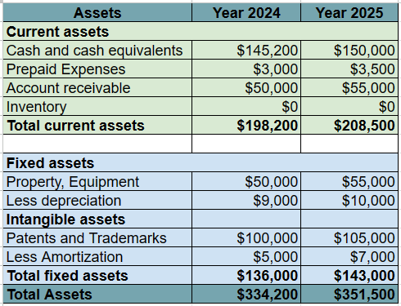
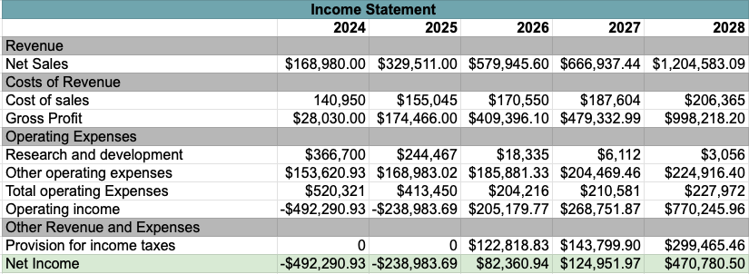
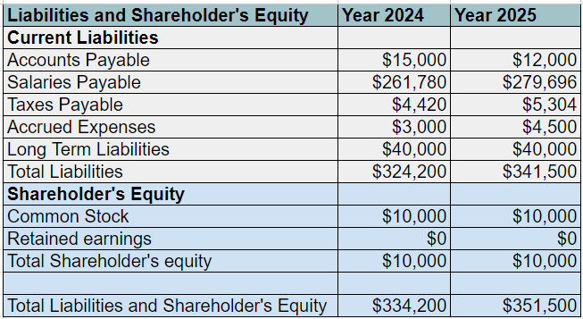
Balance Sheet & Income Statement
Slide by Shruti,Rachana,Patrick
For Balance sheet analysis please find link Team1: Overview of Commercialization

Slide 16
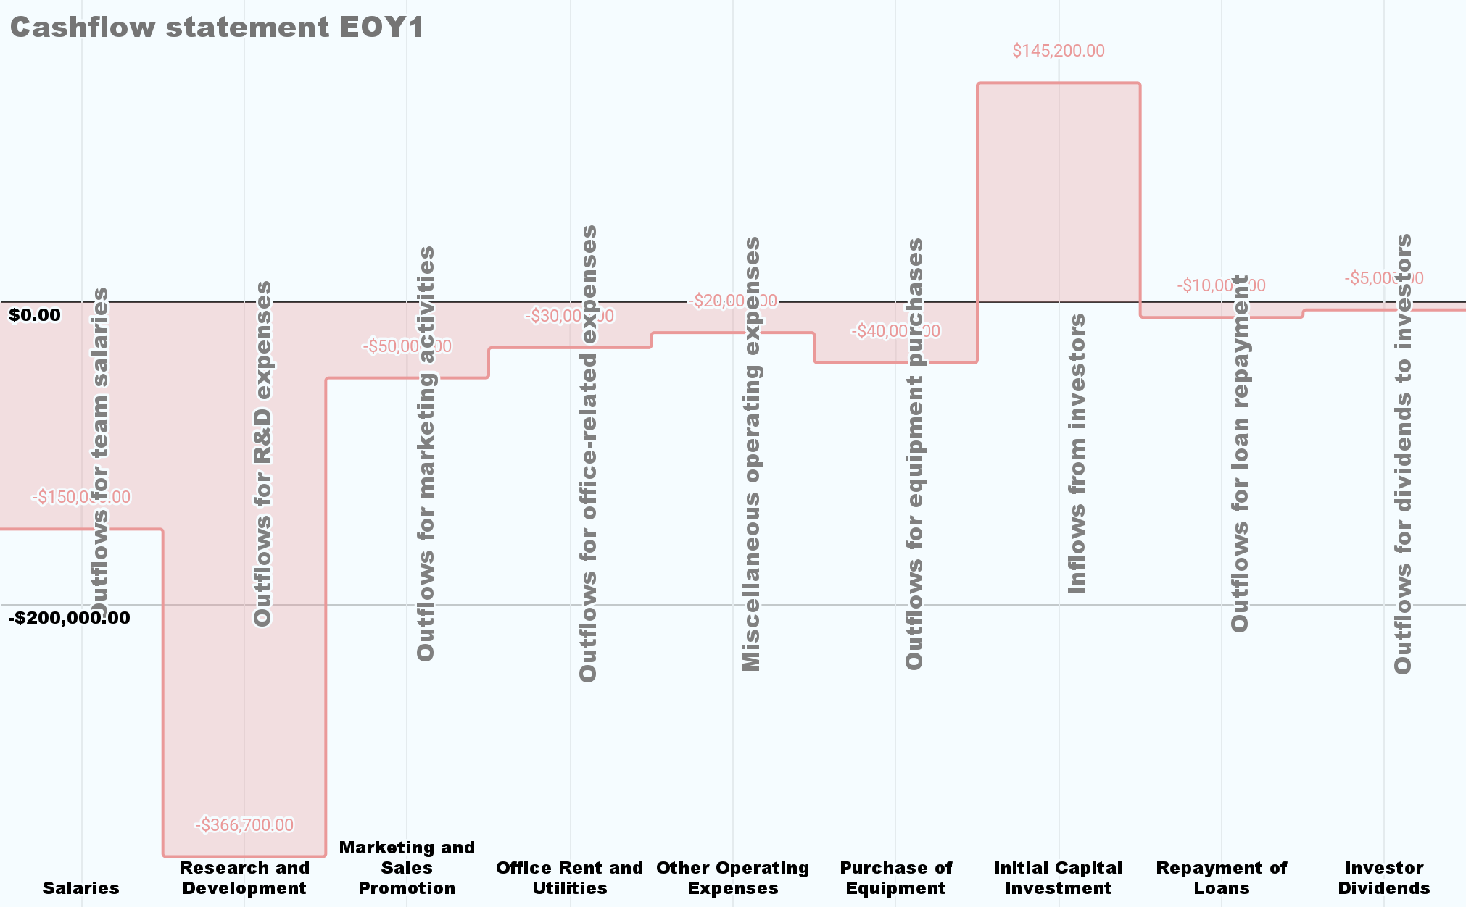
Statement of Cash Flow
Cash at End of Year |  | -$486,500.00
Slide by Mihir

Slide 17
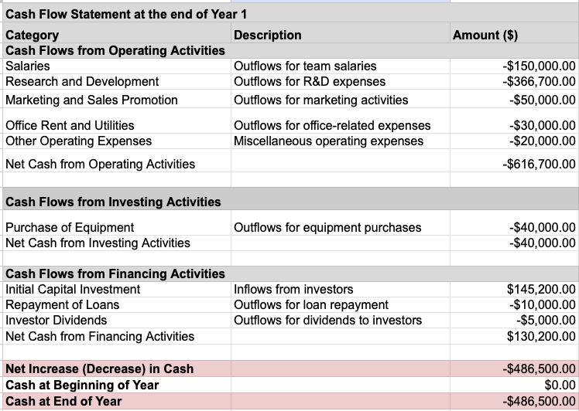
Statement of Cash Flow
Slide by Mihir

Slide 18
Capital Budgeting
Year | 0 | 1 | 2 | 3 | 4 | 5 | 6 | 7 | 8 | 9
NCF | -$491,791 | -$233,759 | $89,520 | $133,487 | $495,175 | $583,617 | $650,396 | $713,031 | $771,108 | $824,172
Cum. NCF | -$491,791 | -$725,550 | -$636,030 | -$502,543 | -$7,368 | $576,250 | $1,226,646 | $1,939,677 | $2,710,785 | $3,534,957
NPV | $1,823,318 |  |  |  | IRR | 36%
Slide by William

Slide 19
05
Valuation
Slide by Mihir

Slide 20
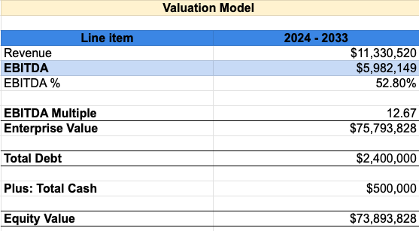
Valuation
Slide by Patrick

Slide 21
Thank You !
~Team AquaChain

Slide 22
References
Cash flow management and financial statement analysis: https://www.investopedia.com/
Accounting standards: https://www.fasb.org/
Cost Plus pricing Model https://www.paddle.com/blog/cost-plus-pricing
Business Market Value https://www.thehartford.com/business-insurance/strategy/selling-a-business/determining-market-value
Slide by Mihir

